Slide 1




Effective Didactic and Practicum Teaching Strategies
Ashley Smith, M.Ed., CST, FAST
Tammy Schaefer, BSOL, CST, CSFA

Slide 2
Generation Groups
The Greatest Generation: born 1901-1924 (Great Depression)
The Silent Generation: born 1925-1945 (McCarthy era, WWII consequences)
The Baby Boomer Generation: born 1946-1964
Generation X: born 1965-1979 (inception of the internet)
Generation Y/Millennials: born 1980-1994
Generation Z: born 1995-2012
Generation Alpha: born 2013-2025 (21st century)

Slide 3
Baby Boomer Generation
One of the most relevant groups due to being present for many of the technology advances in the past 50 years.
More adaptable to modern growth and learning how to function in today’s technological age.
More personally-focused.
Prefers to be in a face-to-face classroom
Appreciates reflection and feedback, rules, boundaries
Education is a birthright
Communication is with touch-tone phones and a “call me anytime” disposition.

Slide 4
Gen. X
The most fiercely independent
Prioritizes self-directed educational opportunities to learn on their own schedule. Rolls eyes at ground rules.
Serve as a bridge from older populations to younger ones.
Present for the inception of the internet, video games, AI, and is the population that has created many of these advances.
Education is “a way to get there”.
Communicates with cell phones and wants to be called only at work.

Slide 5
Millennials/Gen Y
Prefers to access information on-demand. Disregards ground rules.
Grew up with the internet. Entertained all the time.
Education is an incredible expense.
Communicates with the internet, cell phones, e-mail
Earns to spend
Product of merged families
Very social
Online learning needs to be quick and interactive.

Slide 6
Gen. Z (Digital Gen.)
Social media
First population to cope with cyber-bullying
School related violence and climate crisis
Communicates on cell phones via text or DMs on social media
More technology access than any other generation at a young age
Education is expensive and may not be necessary (YouTube, etc.)
Instructors struggle to connect and engage

Slide 7
Student Prospective: (Gen. Y & Z)
Current Cohort Dynamics
  14 students - 6 have full time jobs - 2 have children
Value assignment due date reminders
Don’t know how to have a “relationship” with instructors
  Bonding ideas
Too much information at once is overwhelming
Don’t want to be ignored
Start the day with positive intentions

Slide 8
How to be a “good” allied healthcare instructor
Define “good”.
What are your goals, program objectives, university objectives, etc.?
Are you meeting ARC/STSA thresholds?
Exceptional communication and HR skills.
Evaluates students’ intellectual development and is respectful.
Recognizes the different learning styles housed in each cohort and adapts.
Three types: empathetic, competence-centered, and innovative

Slide 9
Empathetic Instructor (Gen Y instructors)- Affective Domain
I am understanding
I am patient
I am strict
I am always available for the students
Care and compassionate yields better communication

Slide 10
Competence-Centered Instructor: Cognitive Domain
I am well-qualified for my job
I treat my students like adults
I am very hands-on in teaching students
I set expectations for student learning and behavior
Better pedagogy content knowledge + enthusiasm = higher achievement gains and competent healthcare professionals

Slide 11
Innovative Instructor: Psychomotor Domain
I am enthusiastic
I am into interprofessional and learning collaboration
My classes are interactive
I can apply learning to real-life experiences
I use technology effectively and efficiently
I have effective teaching strategies
Allows exploration of identity and learning differences to promote innovative and collaborative professionals

Slide 12
The need for flexibility (Gen X instructors)
Gen X and higher desire a balance between work and life.
Flexible lecture hours are possible if online/Clinical hours cannot be flexible. This is a give and take.

Slide 13
Knowles’ Andragogical Model
The need to know: Why am I learning this?
The learners’ self-concept: I am self-directed.
The role of the learners’ experiences: I have life experience.
Readiness to learn: I am ready to learn cognitively.
Orientation to learning: How will I utilize this material in real-life?
Motivation: What are the external/internal motivators?

Slide 14
Gardner’s Theory of Multiple Intelligences (8)
Linguistic: Sensitive to spoken/written language (lawyer, author)
Logical-Mathematical: Analytical/number smart (accountant)
Spatial: Recognize/manipulate wide space (pilot, surgeon, architect)
Bodily-Kinesthetic: Use whole body (surgeon, surg tech, pt, mechanic)
Musical: Recognize/create music (singer, DJ, composer, musician)
Interpersonal: Understand intentions/desires (teacher, manager)
Intrapersonal: Understand oneself (therapist, clergy, counselor)
Naturalist: Recognize species/environment (botanist, astronomer)

Slide 15
How to use theory?
Theory can be used as foundational information and research to create effective teaching methods that will satisfy and engage all generations and learning styles/intelligences.

Slide 16
Didactic:
Learner-centered approach:
Study-learning with higher educational efficiency
Consider previously acquired knowledge
Align educational process with goals/needs of learner
Support learner’s initiative and responsibility
Encourage learning by doing (kinesthetic)
Create feedback opportunities

Slide 17
Didactic Continued
Case studies
Legos/play dough
Stations
Presentations
Technology (videos, supplemental resources with textbook, software)
Games
Reflection periods

Slide 18
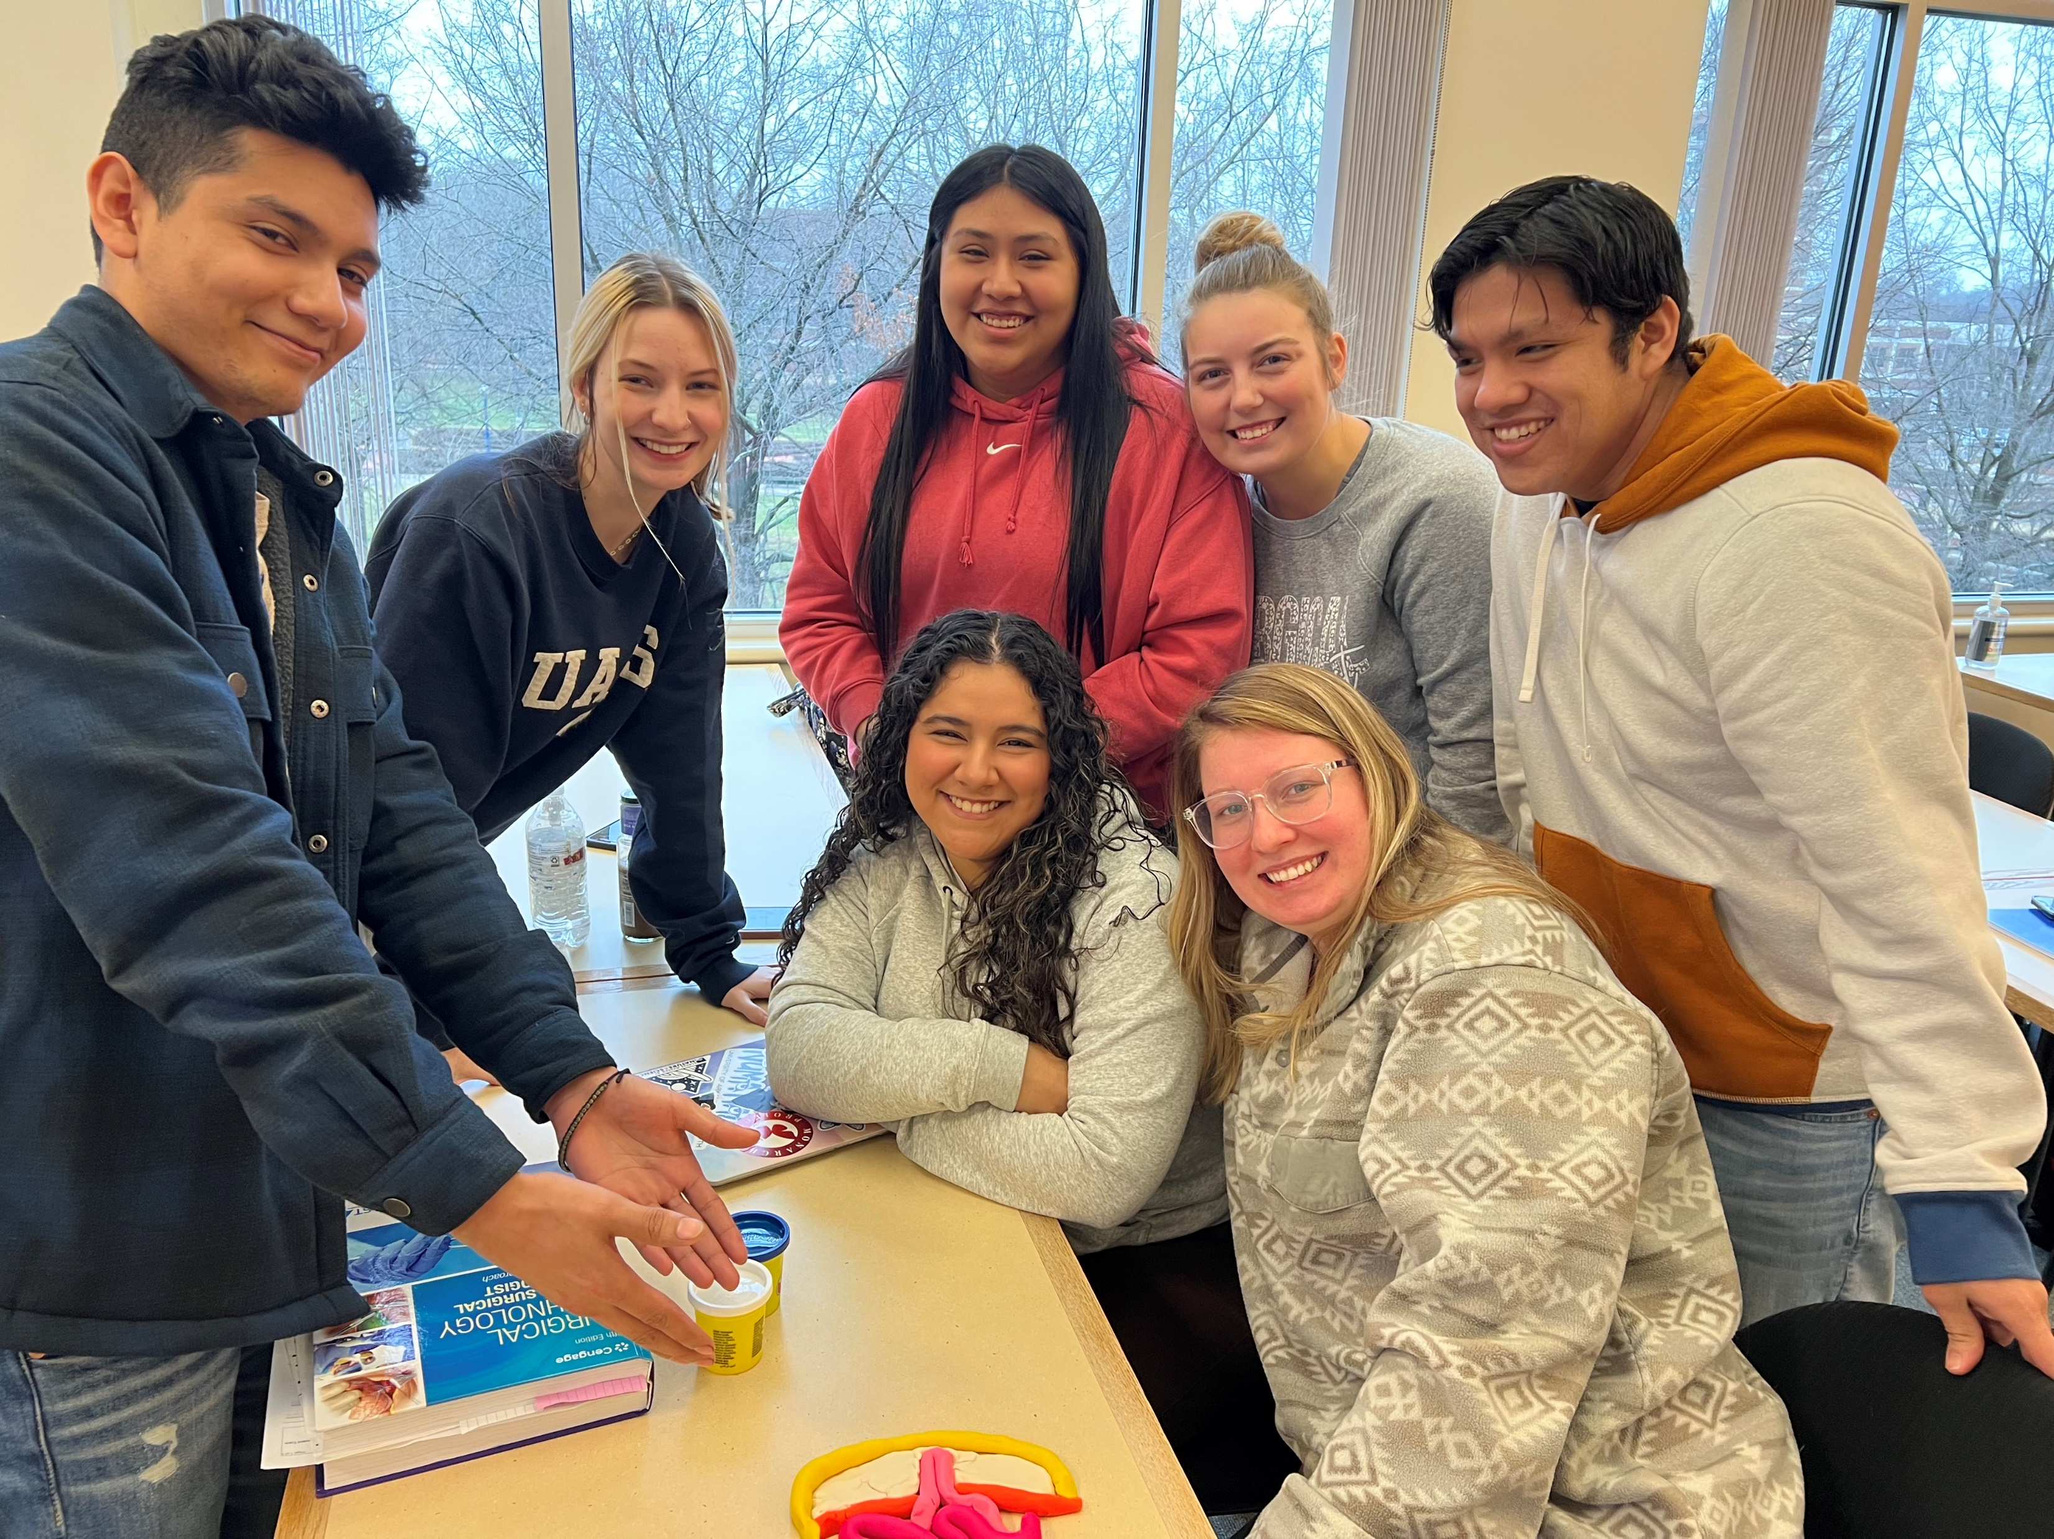

Hernia with playdough

Slide 19


Student Perspective: (Gen. Y & Z)
Lab lectures – too much to take in all at once
Learn better with hands-on techniques
….2 hours
without TikTok.
UNSURVIVABLE
Instructors =
Students =

Slide 20
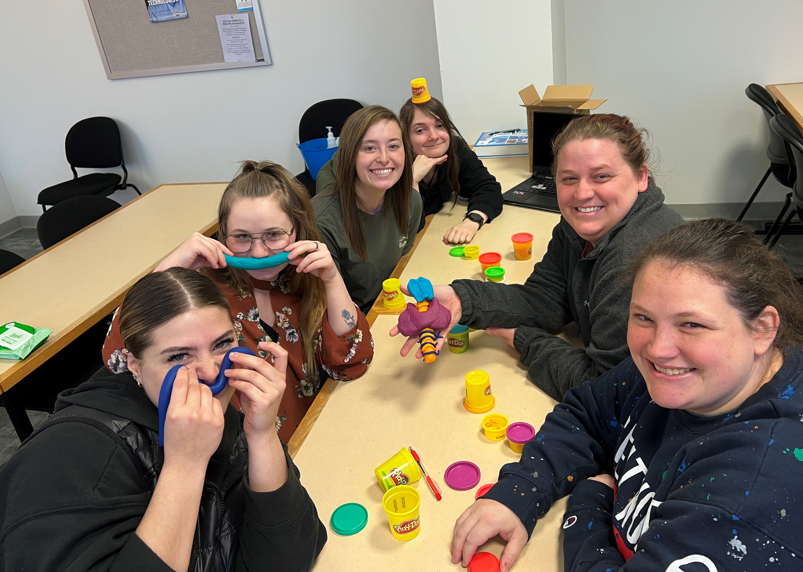
Playdough thyroid

Slide 21
How Class Starts:
Brain warm-ups: thinks outside the box
1 at 3:46 pm 13579 AZ ECNALG
NAFISH ONE DOCTOR
NAFISH ONE DOCTOR
NIRENDEZVOUSGHT

Slide 22
Know, Want, How, Learn (KWHL) Diagram (Brainstorming) and Other Active Learning Strategies for Remembering and Retrieval
What do I KNOW? | What do I WANT to know? | HOW will I find out? | What did I LEARN?
Structures of Upper GI: | Dysfunctions of Upper GI:
Structures of Lower GI: | Dysfunctions of Lower GI:
Process of Digestion: | Diversions/Treatments for Alterations in Digestion?
Open-ended probe on special populations unit:
What do you think of when you think of the elderly?
How do you picture yourself when you are elderly?
What would be your three most essential physical concerns?
What would be your three most essential psychosocial concerns?
Draw a diagram depicting the flow of cardiac blood through the arteries in red and the veins in blue.

Slide 23
Active Learning Strategies for Comprehension and Understanding
RSQC Strategy:
Recall: List words or phrases of most meaningful points from the last class. Underline the most important concept you gained from participation.
Summarize: Write one sentence to summarize the essence of the previous class in personal terms.
Question: Jot down one or two questions that you still may have about the content from the previous class.
Connect: Identify the connection between the concepts learned in the previous class and the goals of and skills to be learned in this course.

Slide 24
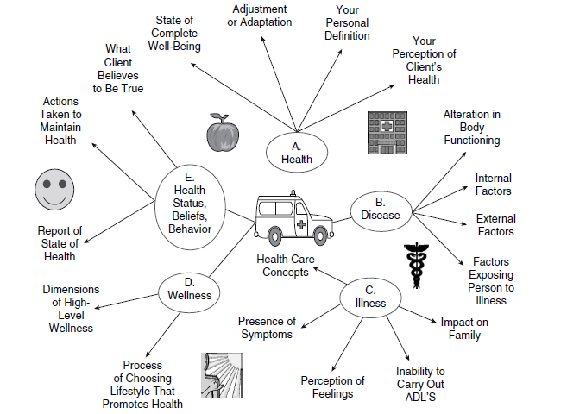
Big Picture Overview of Health Concepts

Slide 25
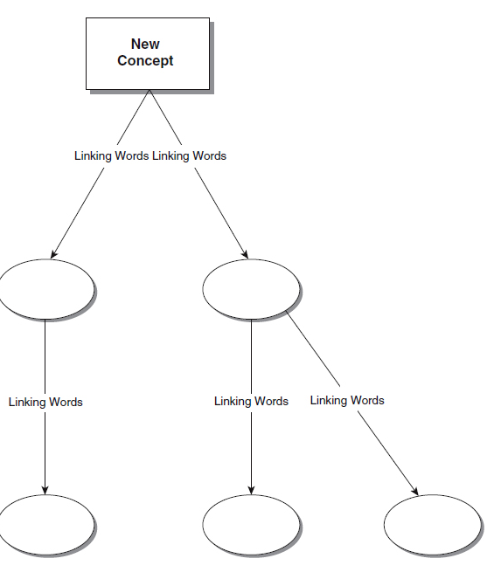
Active Learning Strategies for Application and Deeper Comprehension
Concept Map: To demonstrate relationship between ideas to help analyze information, chain of events, or systems.

Slide 26
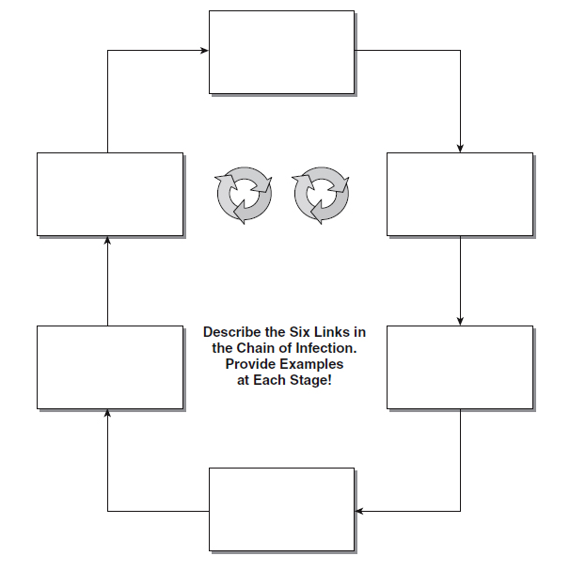
Continued…
Simple cycle web: To demonstrate understanding of cycles and processes at a simple level before introducing more complex information.

Slide 27
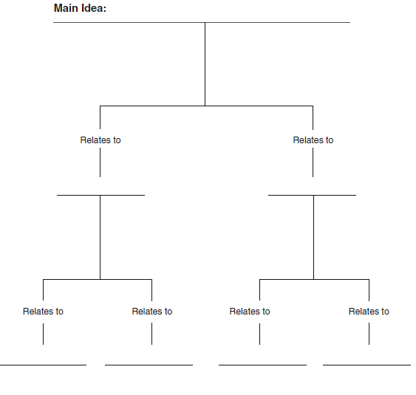
Continued…
Tree diagram: To demonstrate the breaking down of complex ideas into component parts and to allow students to explore relationships between a whole and its parts.

Slide 28
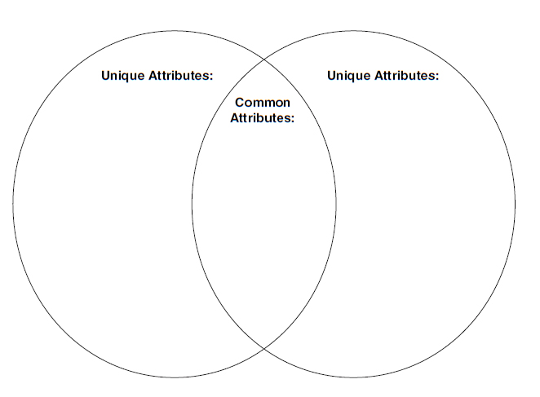
Active Learning Strategies for Analysis:
Venn Diagram: To demonstrate ability to compare and contrast.

Slide 29
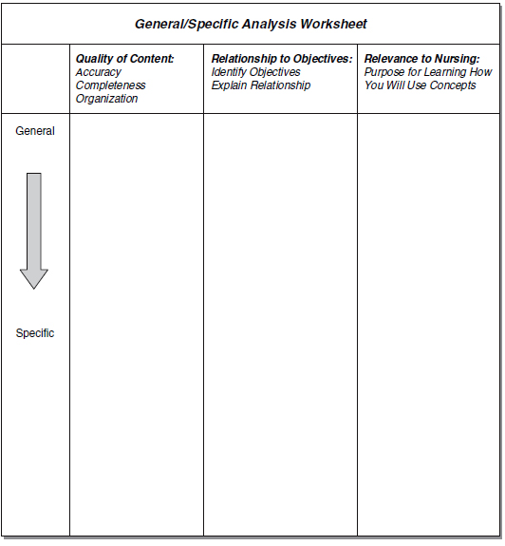
Continued…
General/Specific Analysis for Any Unit of Study: Students analyze each other’s responses to general/specific overview of objectives according to criteria.

Slide 30
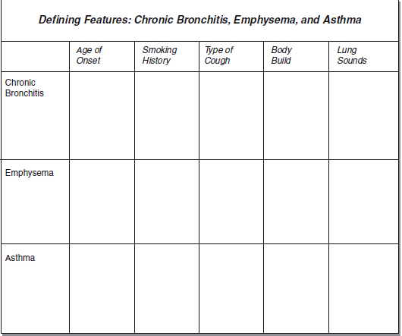
Defining Features Grid for Unit on Respiratory Disorders

Slide 31
Pro/Con Grid for Unit on Pre- and Postoperative Procedures

Slide 32
Student Perspective: (Gen. Y & Z)
LAB
Need things introduced in small quantities
Instrument video
Flashcards are most helpful
Questions Box
Games

Slide 33
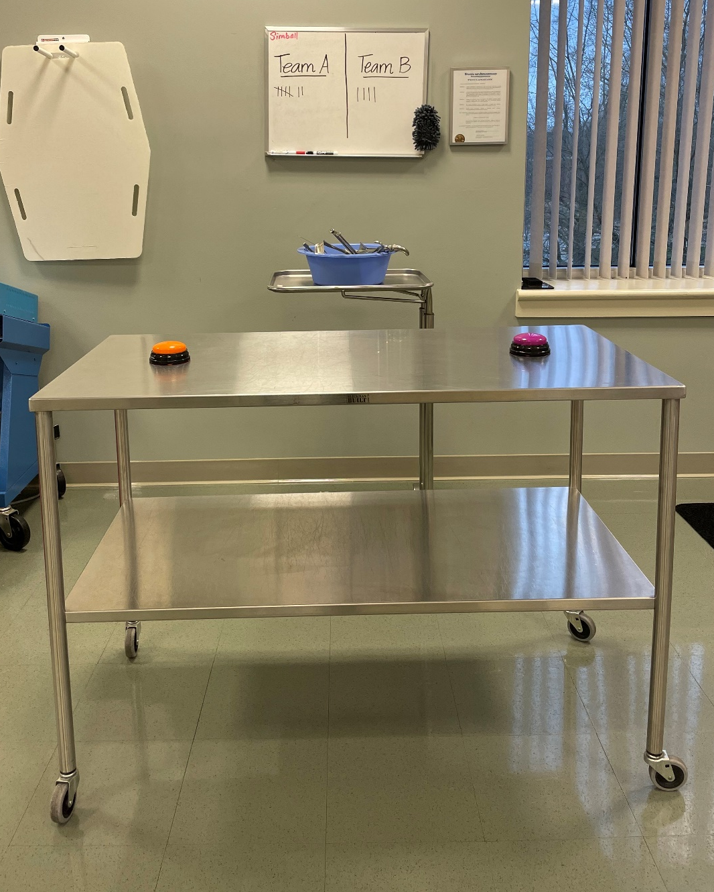
Family Feud Instrument Game

Slide 34
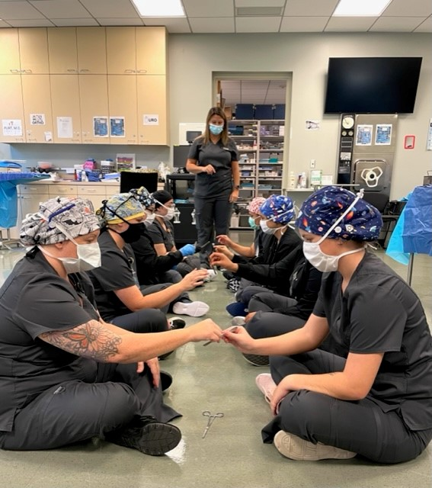




Passing Instruments
This can also be done
in a circle,
like musical chairs

Slide 35
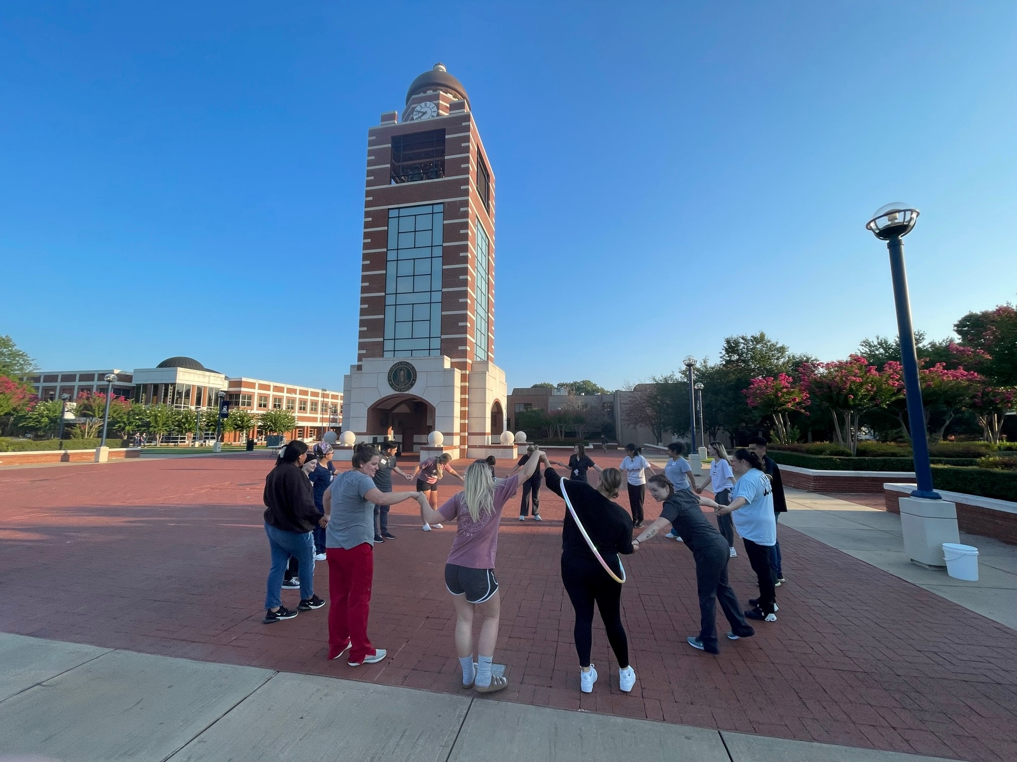
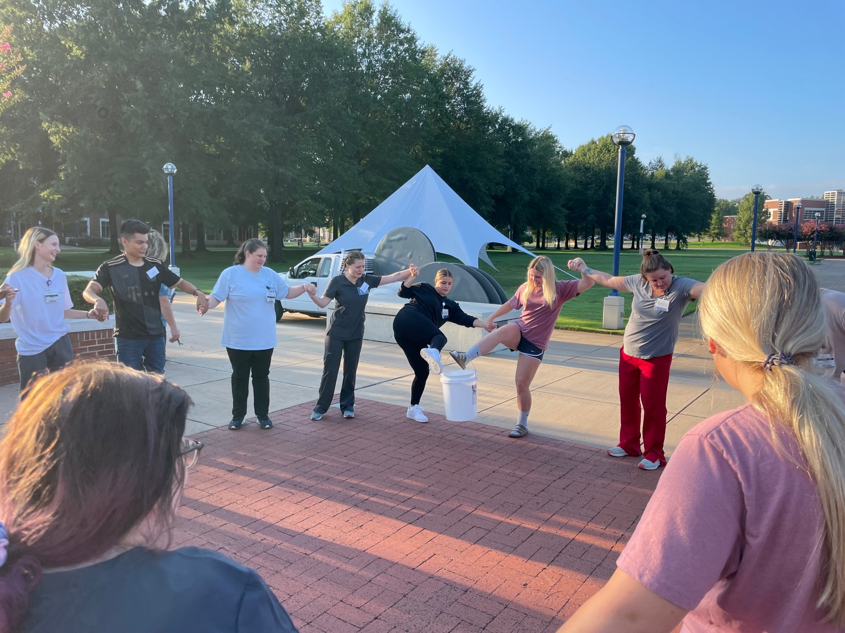


Other Helpful Lab Ideas:
Hula Hoop Challenge
Bonding

Slide 36
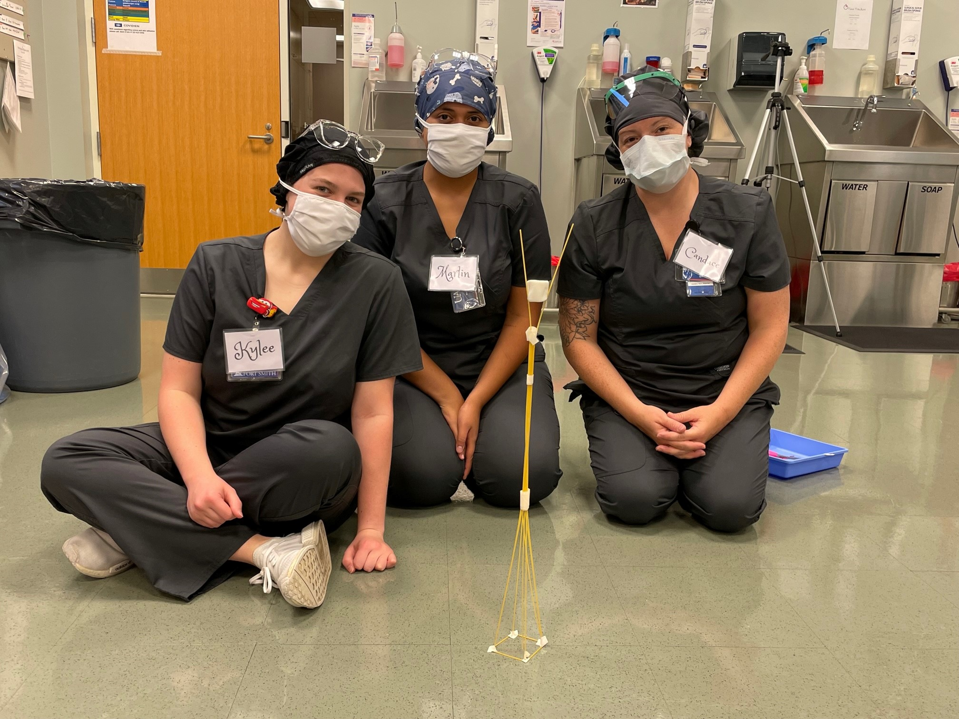



Marshmallow Challenge

Slide 37
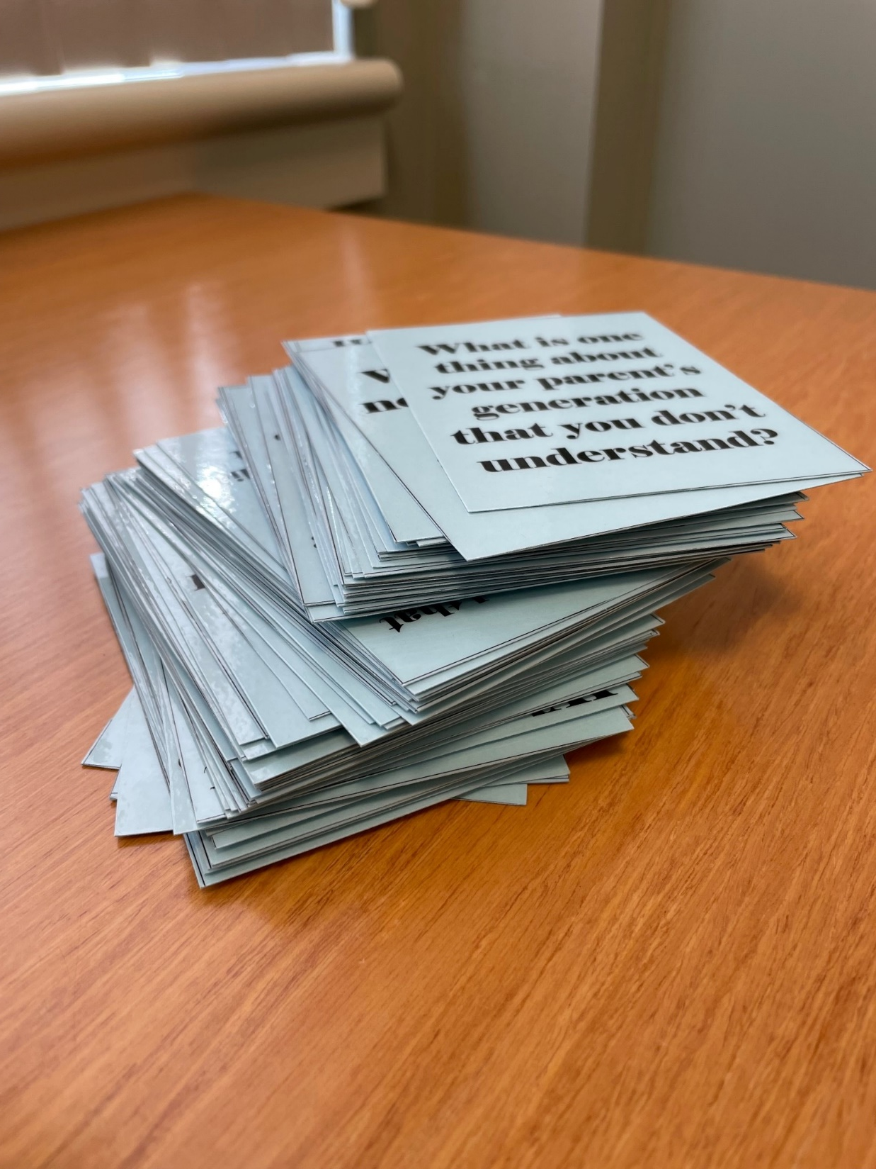
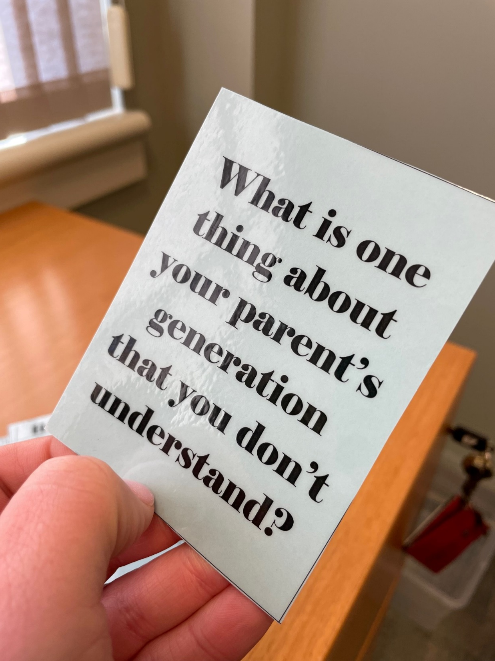
Table Topic Cards

Slide 38
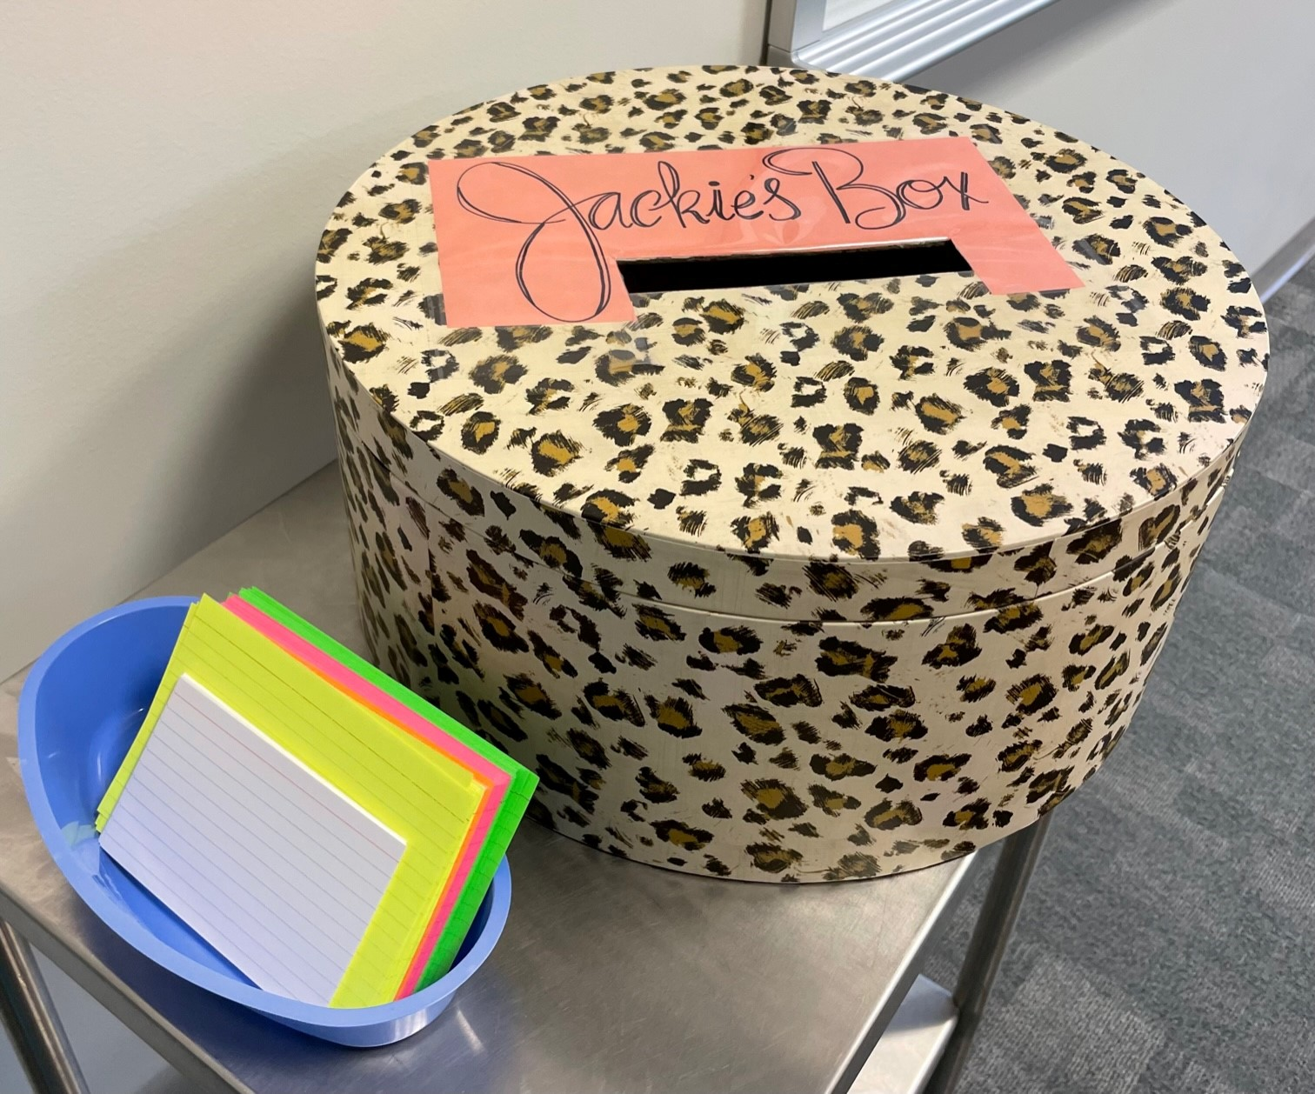
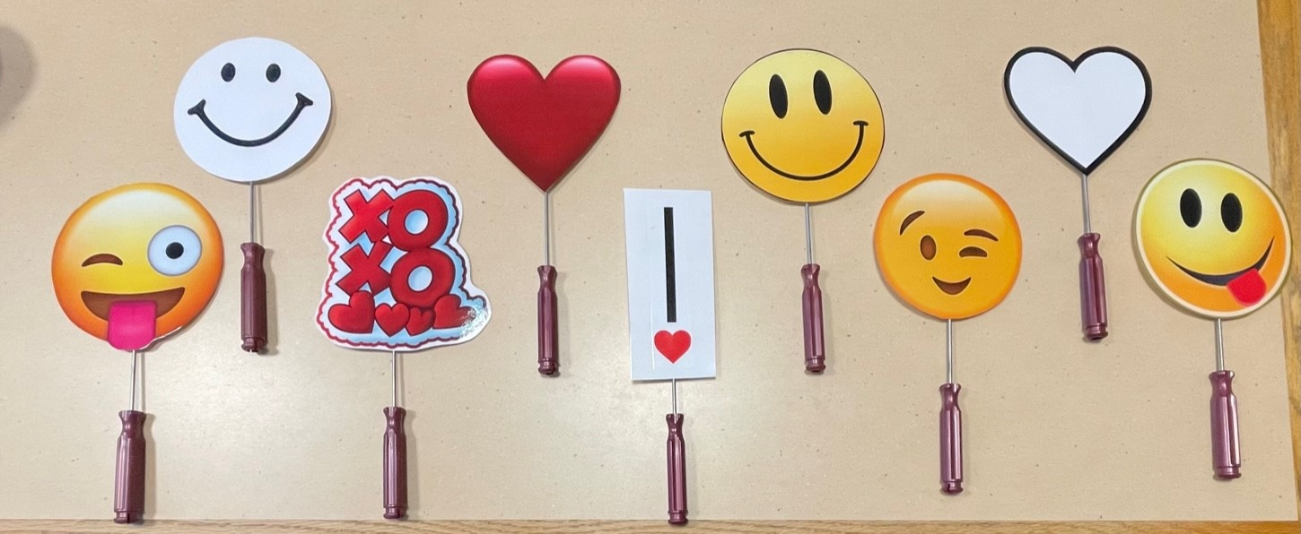
Jackie’s Box

Slide 39
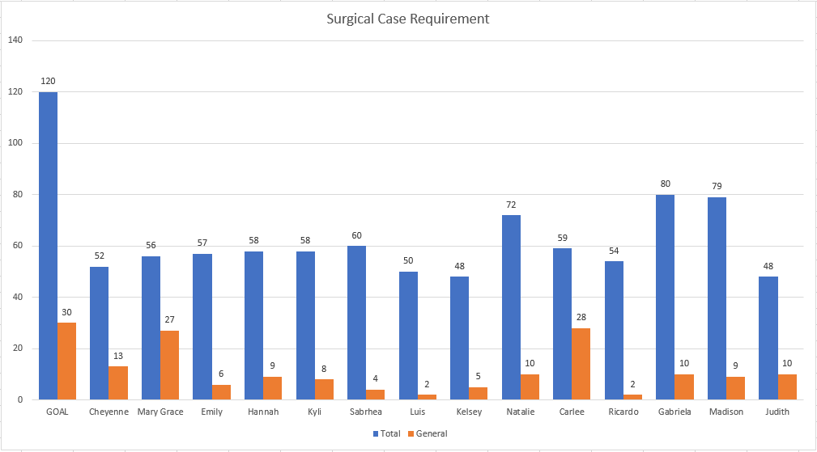
Motivation and Accountability
Post at least weekly on a communication app (GroupMe, Crew, etc.)

Slide 40
References

Slide 41
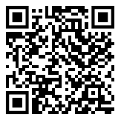
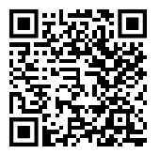
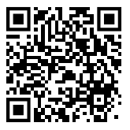
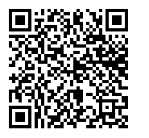
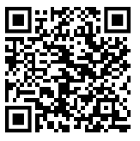
Questions?
Jackie’s Box
Rules
Gen Z
Table Topic Cards
Hula Hoop
Challenge
Marshmallow
Challenge
Post Conf
Table Topic Cards

